Slide 1
Only connect
Mouse
Speakers
Keyboard
Monitor
Scanner
Temperature sensor
Printer
Motor
Link | 1 | 2 | 3 | 4

Slide 2
What are we learning
What is inside in the box?

Slide 3
Success Criteria
Level of success | Criteria
Good | You can identify the major components of a computer system
Great | You can describe the role the components play in the computer system
Outstanding | You can explain why a computer system has two different types of memory

Slide 4
A Computer System

Slide 5
A Computer System
Input Device
Processor
Output Device
Storage Device

Slide 6
What will you see
What can you find out?
Can you do some research and see if you can find out what we will see when we take apart a computer

Slide 7
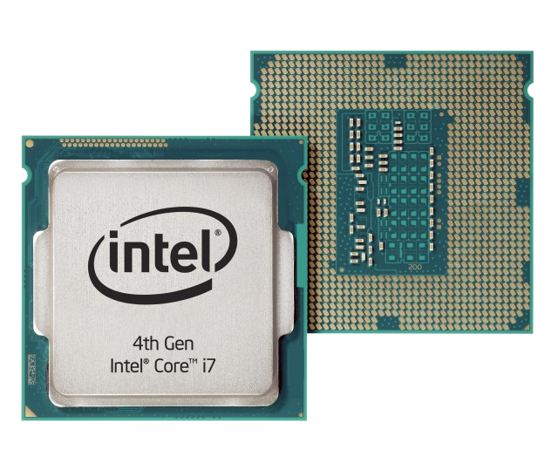
What will you see – THE CPU

Slide 8
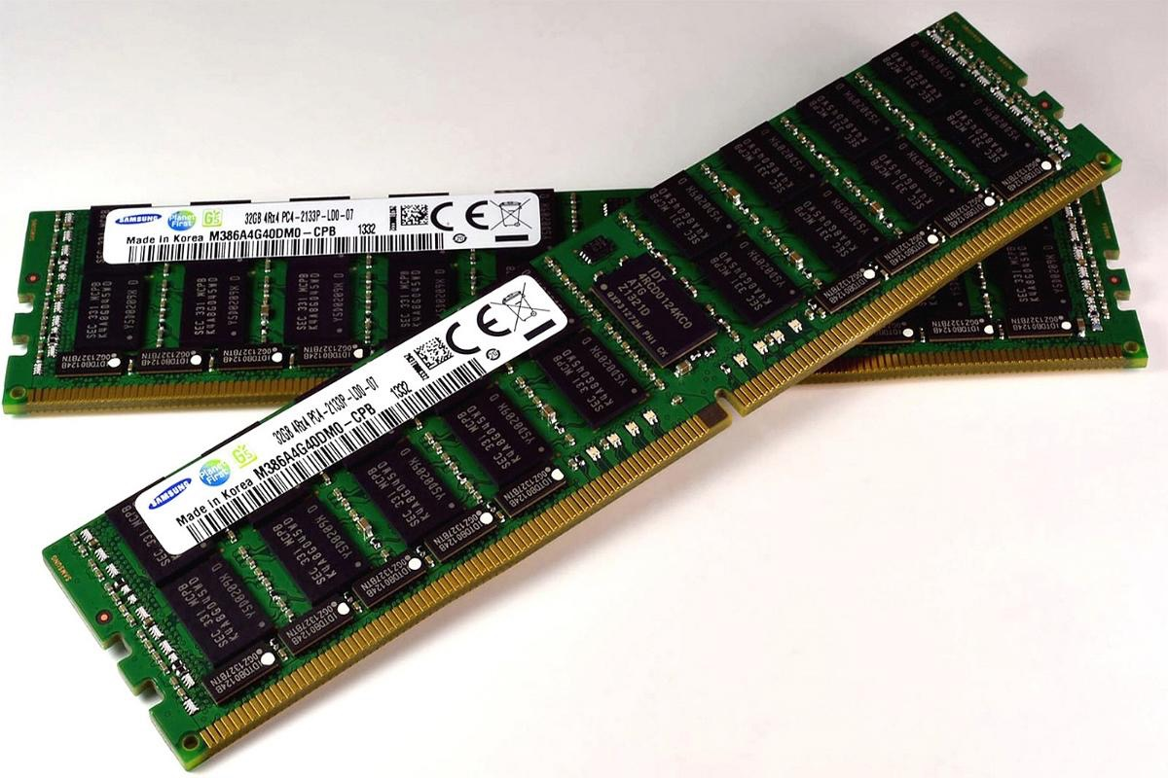
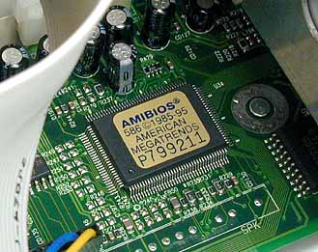
What will you see – PRIMARY STORAGE
RAM
ROM

Slide 9
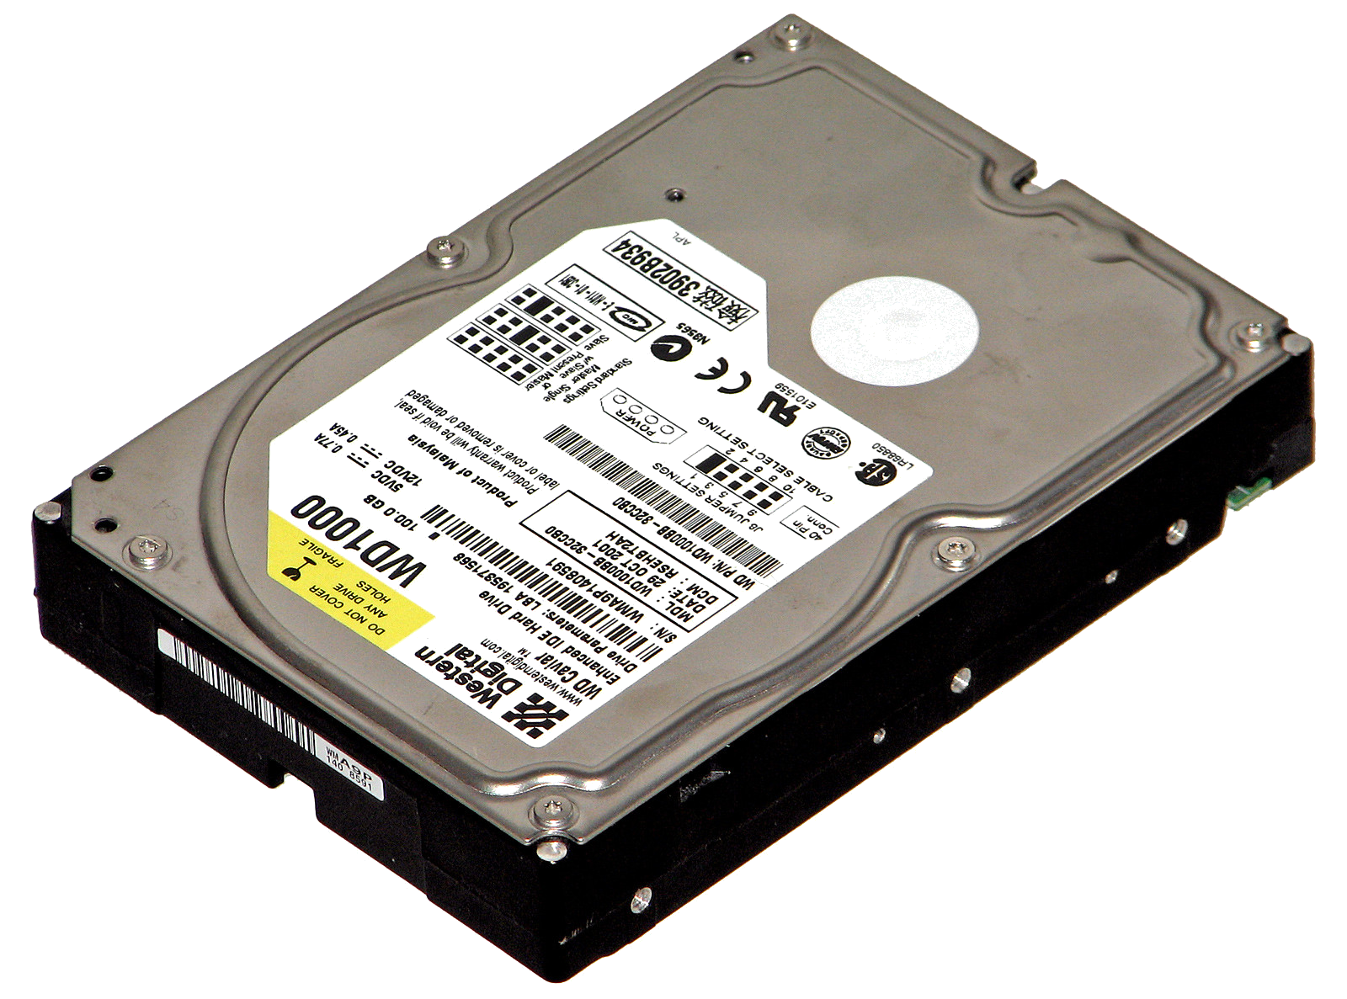
What will you see – SECONDARY STORAGE

Slide 10
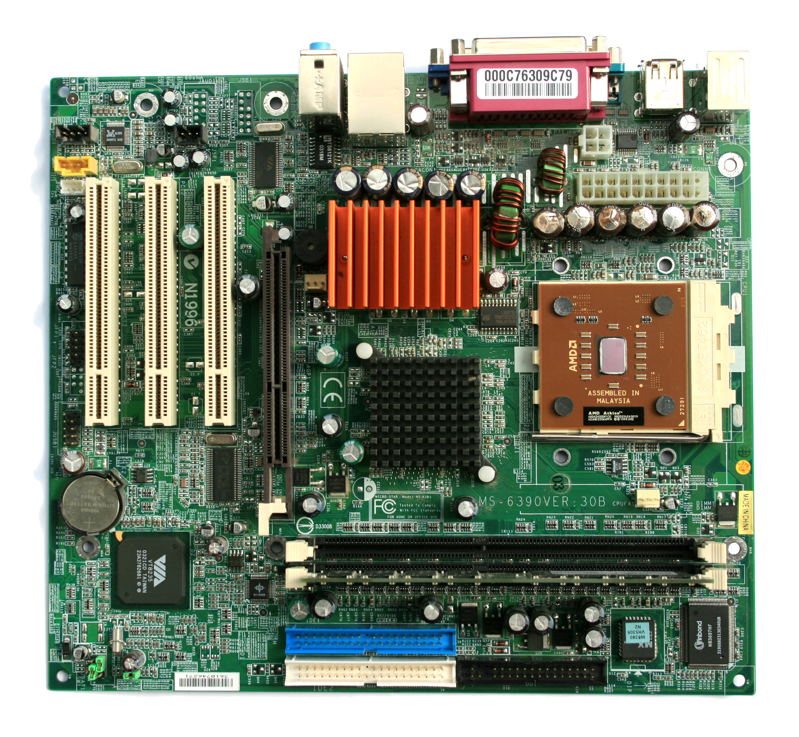
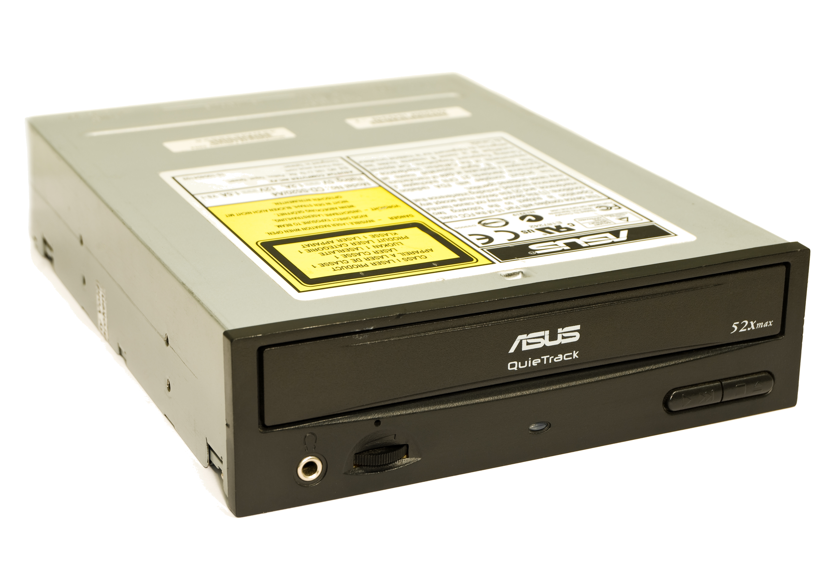
Anything else

Slide 11
Task
Have a go at taking apart the machine in front of you
Take photographs using your MED as you go
Make sure you can put it back together at the end

Slide 12
hmmm….
Why is there a lump of metal on top of the processor?
What is everything plugged into?
Why is there two different types of storage?
Why is there a battery?
What is the BIOS?

Slide 13
Task
Complete the sheet by adding your image and a description of what the component does
You should find a link to the sheet to complete on the VLE
When you have finished, share the document with me

Slide 14
To finish
What does the processor do?
What is the RAM for?
What is the ROM for?
Why do we have two different type of storage?
How do we measure the performance of the processor?
How do we measure the amount of storage?

